Slide 1

Introduction to Computer Systems
Computer Components
Direct Link to view these slides on Google Docs

Slide 2
What to expect in this topic:
Computer Components, types and architecture
Universality
MIPS internal structure and RAM
Operation of Computer (Execution)
Memory simple structure, memory capacity and size
Differences between High Level Language, assembly and Low Level Language

Slide 3
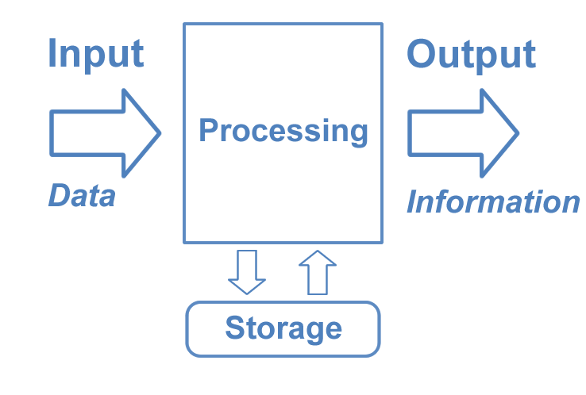
Computer
An electronic device which is capable of:
Receiving data (input) in a particular form (Digital/Analog)
Performing a sequence of operations (processing) in predetermined manner in set of procedural instructions (program)
Producing a result (output) in the form of information or signals.

Slide 4
Universality
Universal and not universal computers
Universal computer – capable of arbitrary computation – equivalent to a Turing machine!
Non universal – only able to perform limited calculations – e.g. pocket calculator, central heating controller, microwave controller…

Slide 5
Types of Computer
Analogue
Digital
Hybrid
Supercomputer
Mini Computer
Mainframe Computer
Micro Computer

Slide 6
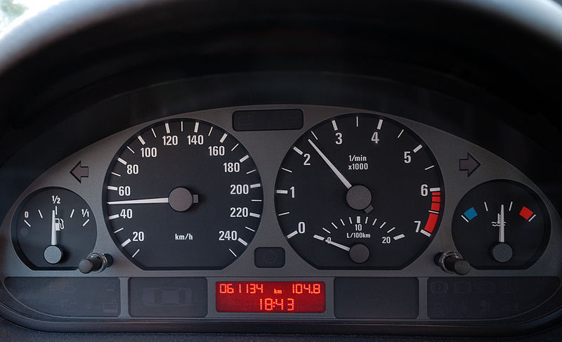
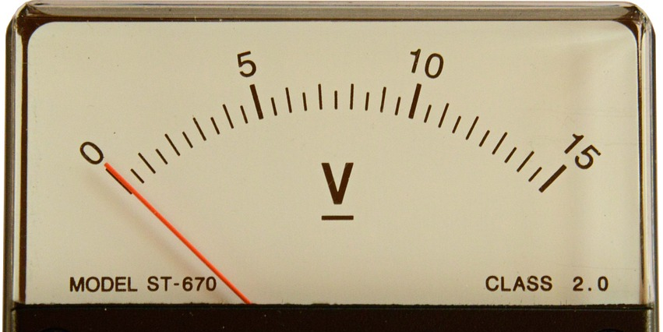
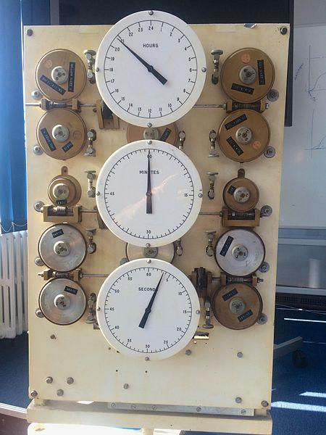
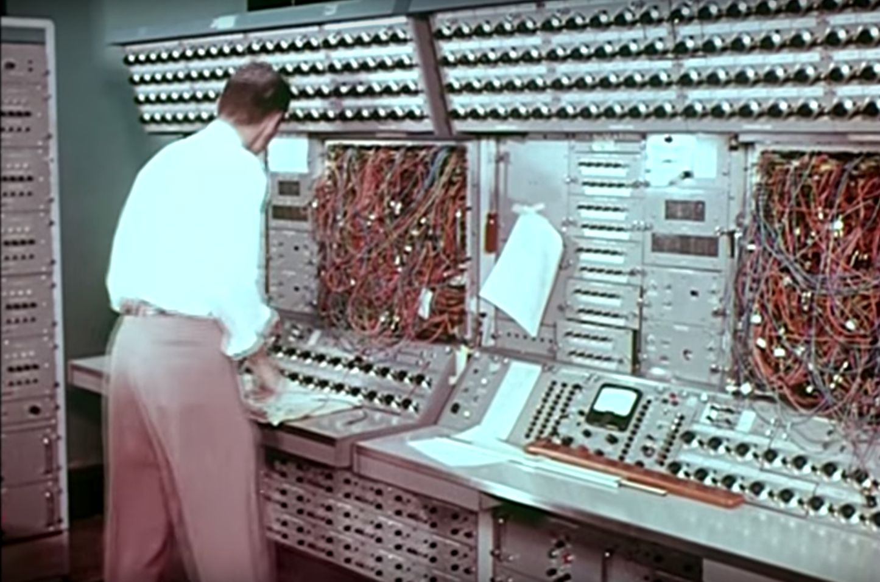
Analog Computer
A computer that operates with numbers represented by directly measurable quantities (such as voltages or rotations).
A form of computer that uses the continuously changeable aspects of physical phenomena such as electrical, mechanical, or hydraulic quantities to model the problem being solved.

Slide 7
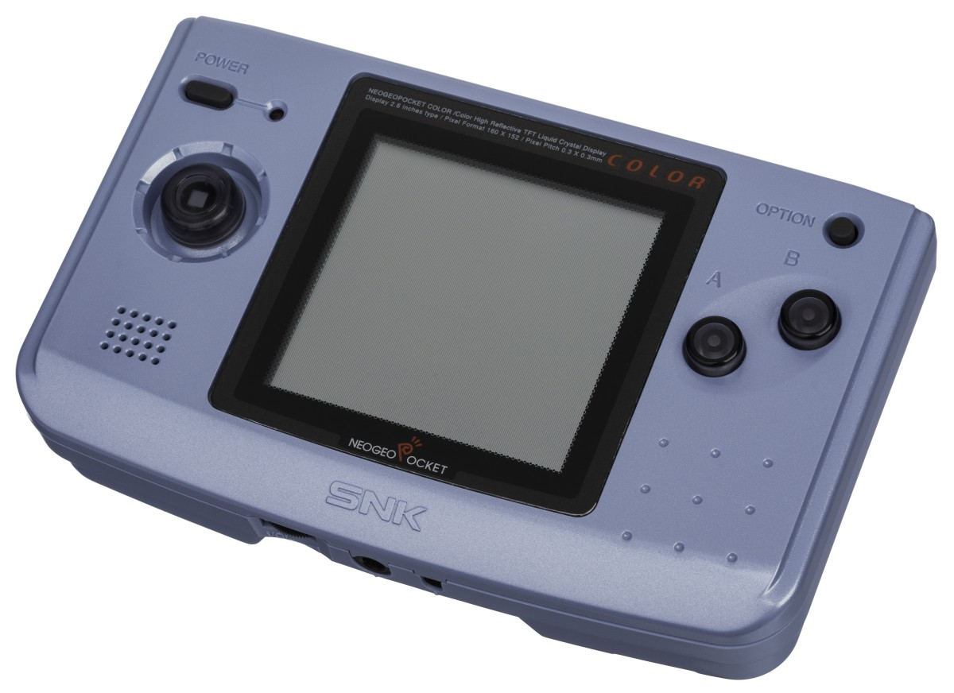

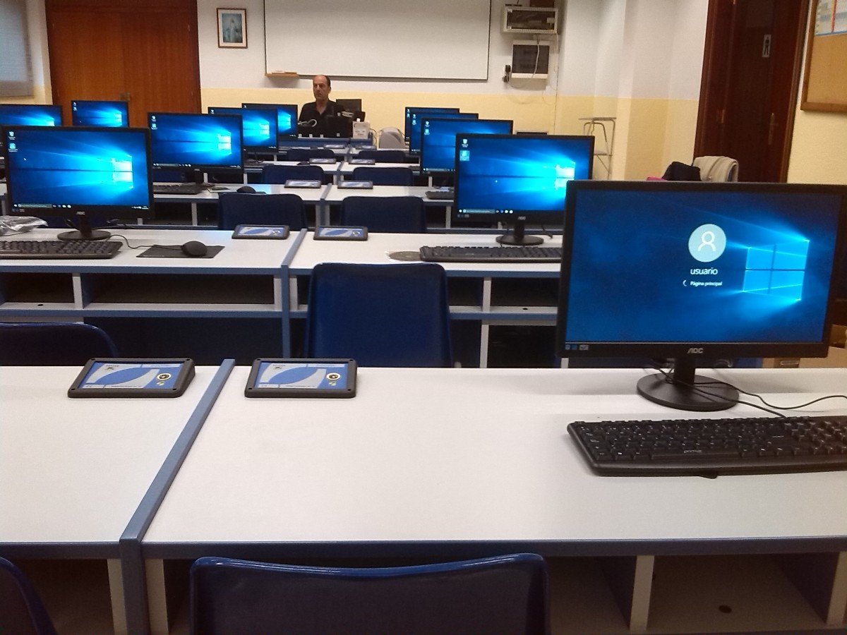
Digital Computer
The most commonly used type of computer and is used to process data with quantities using digits, usually using the binary number system.

Slide 8
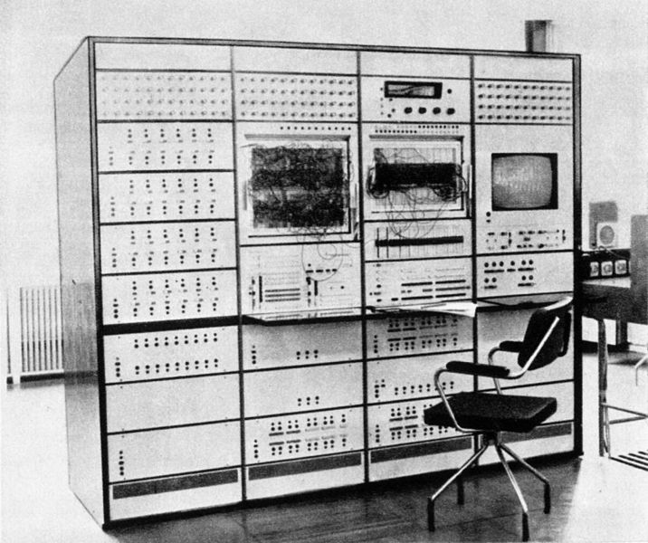
Hybrid Computer
Hybrid computers are computers that exhibit features of analog computers and digital computers.

Slide 9
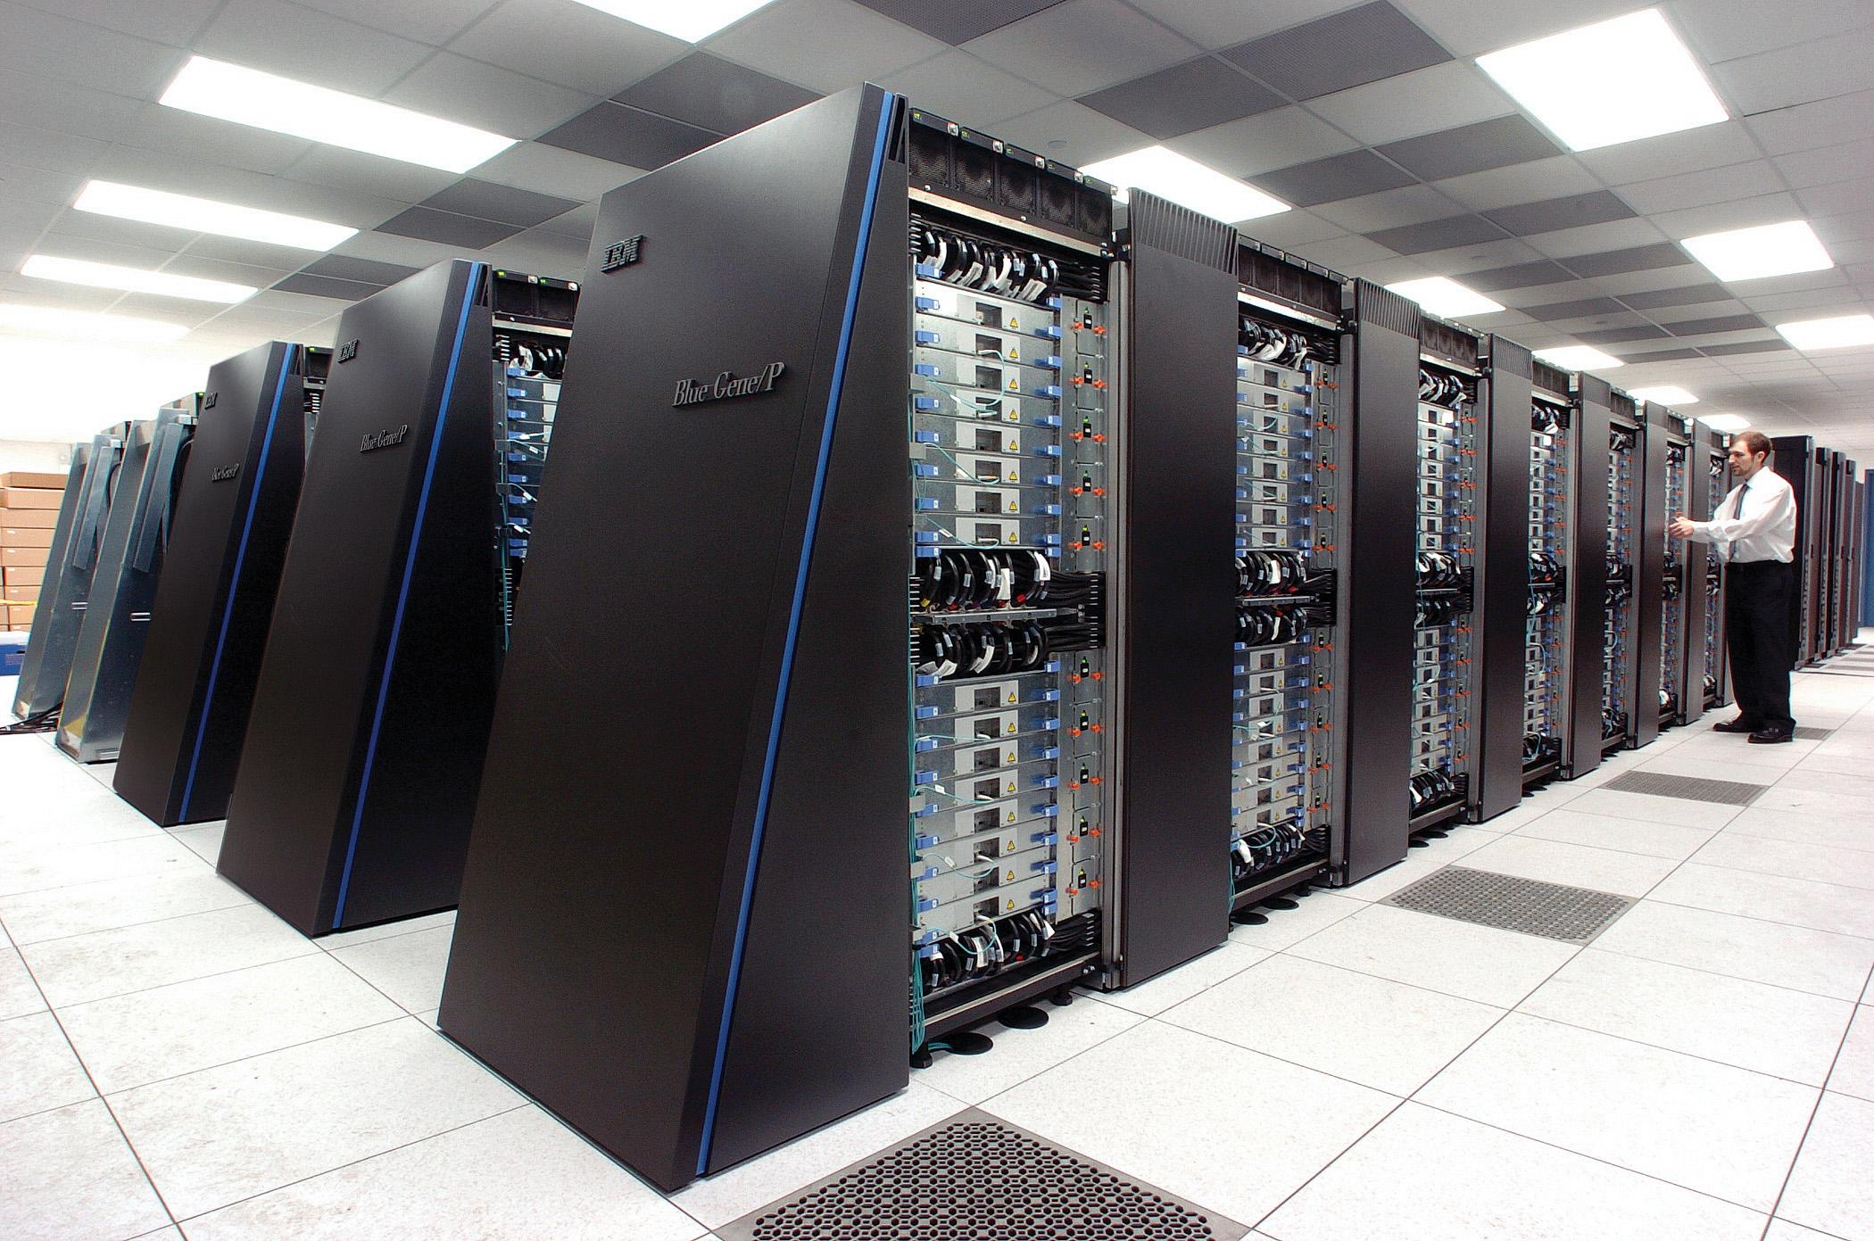
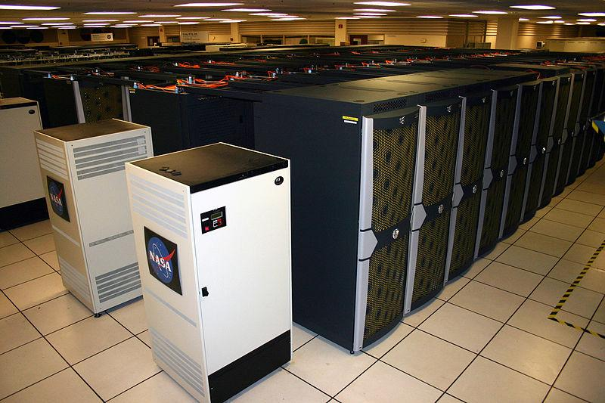
Supercomputer
A supercomputer is a computer that performs at or near the currently highest operational rate for computers. Traditionally, supercomputers have been used for scientific and engineering applications that must handle very large databases or do a great amount of computation (or both)
What these machines can do in a single day would take the average PC about 20 years.

Slide 10
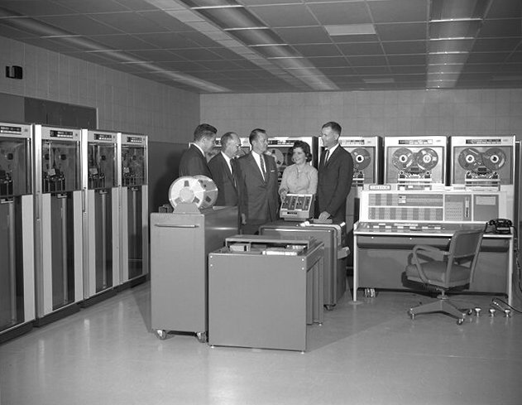
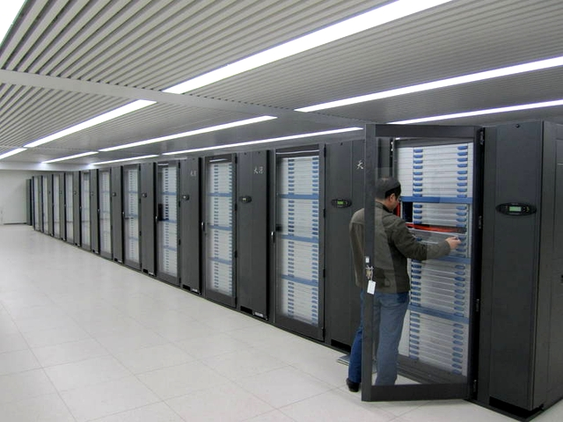
Mainframe Computer
Mainframe computers (colloquially referred to as "big iron") are computers used primarily by large organizations for critical applications, bulk data processing.
IBM developed its first mainframe computer, known as the Automatic Sequence Controlled Calculator (ASCC), in 1944.

Slide 11
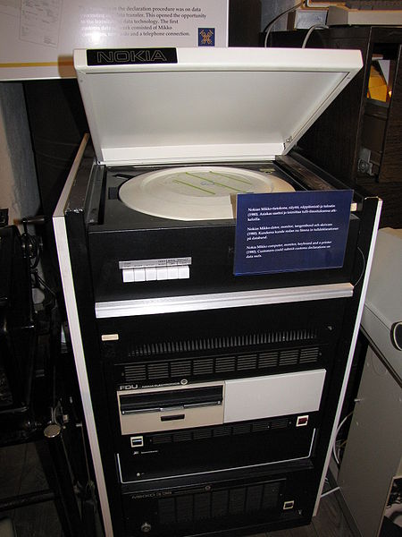
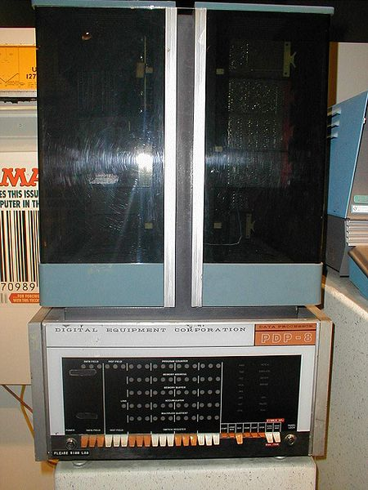
Mini Computer
A computer of medium power,
more than a microcomputer but less than a mainframe.

Slide 12
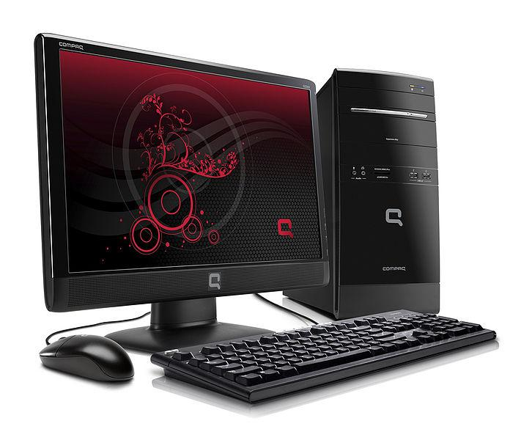
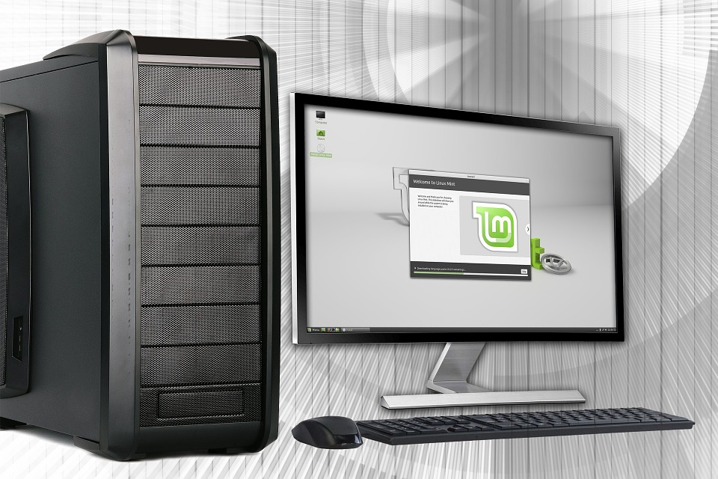
Micro Computer
A microcomputer is a complete computer on a smaller scale and is generally a synonym for the more common term, personal computer or PC , a computer designed for an individual.

Slide 13
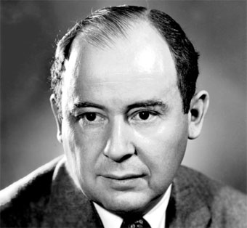
Johann von Neumann (1903 - 1957)
Fundamental structure of a computer
Storing program in same memory as data - allows programs to be manipulated as if they were data
Von Neumann architecture

Slide 14
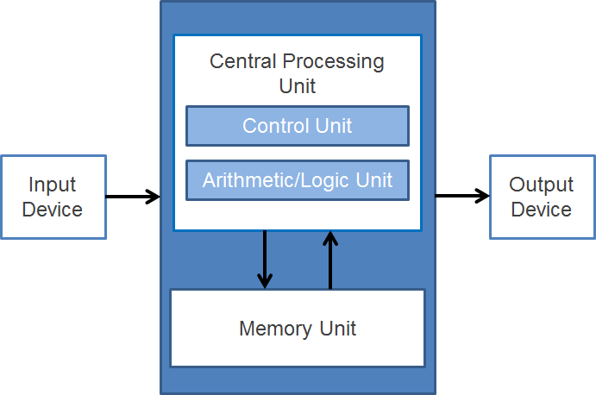
Von Neumann Architecture
In this architecture, the CU (Control Unit) and ALU (Arithmetic and Logic Unit) are linked as CPU (Central Processing Unit)
In general, a computer is composed of: I/O Units, Memory and CPU
For more information on the CPU, please visit: https://www.youtube.com/watch?v=FZGugFqdr60

Slide 15
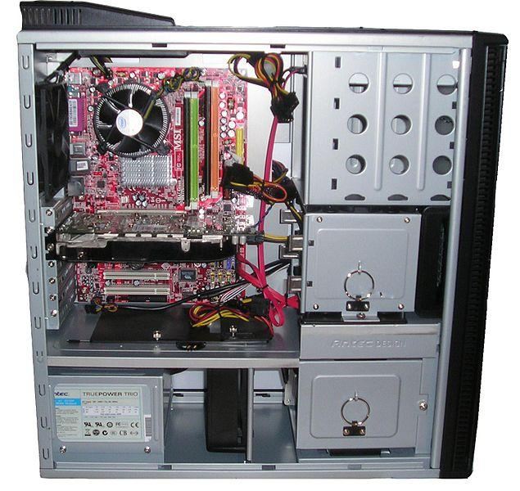
Computers, how are they made?
PC opened up - obviously a new one, there’s no dust!

Slide 16
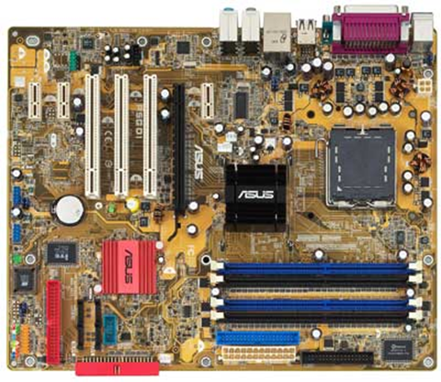
Computer Anatomy
The motherboard connects all components together.

Slide 17
Computer Anatomy
CPU slot
The CPU is a chip that slots into a standard socket

Slide 18
Computer Anatomy
The Power Connector
Power supply is probably the largest box inside your PC.

Slide 19
Computer Anatomy
Battery
This battery keeps the clock running and accurate whist otherwise powered off.

Slide 20
Computer Anatomy
I/O connectors as standard connector for network, keyboard, mouse etc.

Slide 21
Computer Anatomy
Memory slots - Memory cards can be added, but motherboard may constrain the combinations of memory available.

Slide 22
Computer Anatomy
Chip sets
Chip sets control whole motherboard

Slide 23
Computer Anatomy
PCI Slots
Different types of peripherals have different cards

Slide 24
Computer Anatomy
AGP Slot
The Accelerated Graphics Port is for advanced graphics

Slide 25
Computer Anatomy
IDE Connectors
An early form of disk connector

Slide 26
Computer Anatomy
Floppy disk connector
Mostly superseded by USB memory sticks.

Slide 27
Let’s look at different types of CPUs:
MIPS processors
Silicon Graphics workstations
Sony Playstation
DVD players
Networking (telephones, routers, etc.)
Audio players
Digital Frames
Televisions
Printers
Digital Cameras
Intel / Motorola processors
Desktop computers
Laptops
Mobile phones
ARM (Acorn Research Machines) processors
Mobile phones (Samsung Galaxy)
Blackberry
Nintendo DS
Apple iPod
Embedded controllers
Televisions
Printers
Digital Cameras

Slide 28
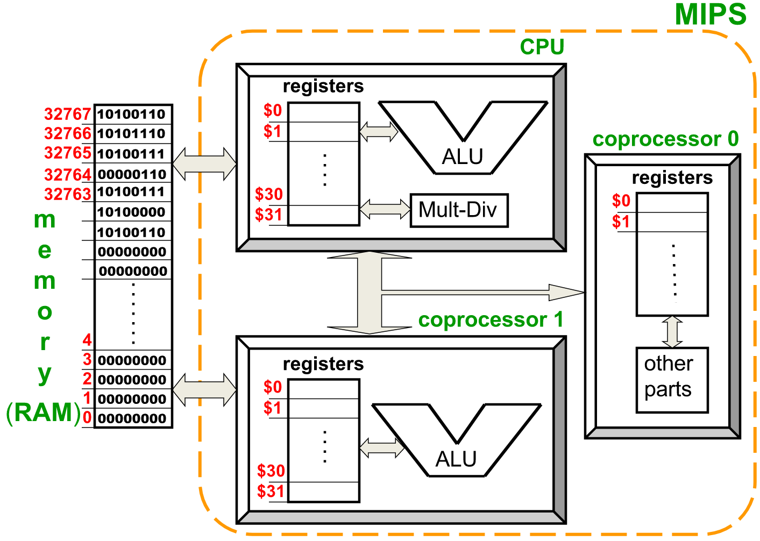
MIPS’ Internal Structure and RAM
This is a representation of the MIPS’ internal structure where there are multiple coprocessors.
Coprocessor 0 deals with system control - each register is used to control some aspect of machine
Coprocessor 1 typically provides support for floating point
Note Coprocessor 0 is not directly accessible for memory

Slide 29
A Bit of Memory
Memory is organised as cells, each containing a number of bits.
Together the cells form the RAM, where each cell has an address.
Most modern machines operate with cells of 8 bits - a byte
bits
0, 1
cells
RAM
byte

Slide 30
A Bit of Memory
bits
0, 1
cells
Each byte has an address
For many purposes, sets of bytes are considered together as words, 4 bytes long.
Each word has an address divisible by 4 and consisting of that byte and the following 3.
Double words are also supported by some machines.
Words
RAM
32767
32766
32765
32764
32763
32764
Addresses
32760
byte
4
3
2
1
0
0

Slide 31
Memory: RAM
Random Access Memory
can be both read and written;
volatile.
Dynamic RAM (DRAM):
must be refreshed regularly;
access time ~100ns;
capacity ~ medium;
used for main memory.
Static RAM (SRAM):
no refresh required;
access time ~10ns;
capacity ~too small (1Mbit);
used for cache memory.

Slide 32
Memory
Mass Storage Memory
floppy disk;
CDs & DVDs;
hard disks;
USB memory;
Cloud Storage
ROM : Read Only Memory
written once during manufacture;
can only be read by system;
is nonvolatile.
ROM: [once, factory];
PROM (Programmable ROM) [once, customer];
EPROM (Erasable PROM) [many times, customer];
EEPROM (Electrically Erasable PROM) [many times, customer].

Slide 33
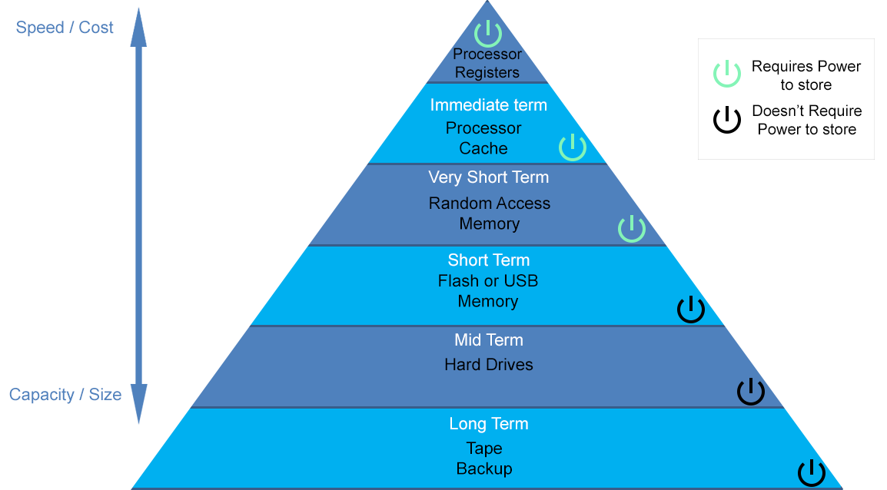
Memory/Mass Storage
For more information on memory and storage, please visit: https://www.youtube.com/watch?v=TQCr9RV7twk

Slide 34
Operation of Computer (Execution)
Fetch-execute cycle
Instructions fetched from address in PC (Program Counter)
Program counter incremented
Instruction decoded
Data for instruction fetched
Instruction executed
If not HALT repeat cycle
Address of first instruction in PC
Fetch: Memory [PC] into IR
Increment PC
Decode Instruction
Execute Instruction in IR
HALT?
No

Slide 35


Computer Programming Languages
As a computer is an electronic machine, it can feel only electricity. It cannot understand human languages. So a computer can understand a language which is directly related to electricity.
So which language can the computer understand?
The answer is binary language or machine language (low language).
Fortan
C
Pascal
High Level Languages
High Level Language
Easy/ Slow
Assembly Language
Machine Language
Low Level Languages
Difficult/ Fast
Hardware

Slide 36
Assembly Language
It is too difficult for humans to write instructions in a pure binary form. So assembly language was developed. It consists of mnemonic codes such as ADD, SUB, STA and so on. These instructions will then be converted to machine language which the computer will happily understand and perform actions accordingly.
Fortan
C
Pascal
High Level Languages
High Level Language
Easy/ Slow
Assembly Language
Machine Language
Low Level Languages
Difficult/ Fast
Hardware

Slide 37
High Level Languages
A high-level language (HLL) is a programming language such as C, FORTRAN, or Pascal that enables a programmer to write programs that are more or less independent of a particular type of computer. Such languages are considered high-level because they are closer to human languages and further from machine languages.
Fortan
C
Pascal
High Level Languages
High Level Language
Easy/ Slow
Assembly Language
Machine Language
Low Level Languages
Difficult/ Fast
Hardware

Slide 38
Below Your Program
Slow / Easy to use and understand
High Level Language (HLL)
i = j + k
Compiler
Assembly language
(for MIPS)
lw $s1, 100($s0)
lw $s2, 40($s3)
add $s4, $s1, $s2
sw $s4, 104($s1)
Assembler
Binary Code
00100000 01100010 00100000 01100010
00010010 00101000 10100000 00100000
00000000 01101000 00010010 00101000
10100000 00100000 00000000 01101000
Fast / Difficult to use and understand
For more information on instructions and programs, please visit: https://www.youtube.com/watch?v=zltgXvg6r3k

Slide 39
Credits
Analogue Computer: Public Domain
Lovell Telescope Analogue Computer: Public Domain Instrument panel: Shared under Creative Commons Attribution-Share Alike 2.5 Generic Licence
Voltmeter: Shared under CC0 Licence
Analogue Computer: Shared under Creative Commons Attribution-Share Alike 3.0 Unported Licence
NeoGeo: Shared Under CC0 Licence
Digital Computers: Shared under CC0 Public Domain Licence
Digital Computers: Shared under CC0 Public Domain Licence
WAT 1001: Public Domain IBM Blue Gene Supercomputer: Shared under Creative Commons Attribution-Share Alike 2.0 Generic Licence
Pleiades Supercomputer: Public Domain
IBM 7090 Computer: Public Domain
Mainframe Computer: Shared under Creative Commons Attribution-Share Alike 4.0 International Licence Nokia Mikko 3 Minicomputer: Public Domain
PDP-8 Minicomputer: Public Domain Desktop PC: Shared under Creative Commons Attribution-Share Alike 3.0 Unported Licence
Linux Desktop PC: Shared under CC0 Public Domain Licence Computer from the Inside: Public Domain

